Slide 1
Walk in Place
Lesson 4

Slide 2


Review

Slide 3
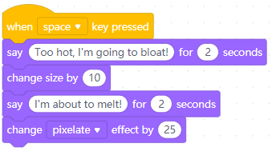

Review
Example program | Program effect

Slide 4

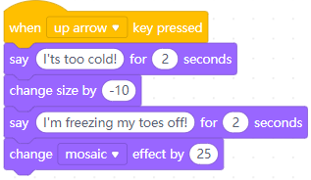
Review
Example program | Program effect

Slide 5
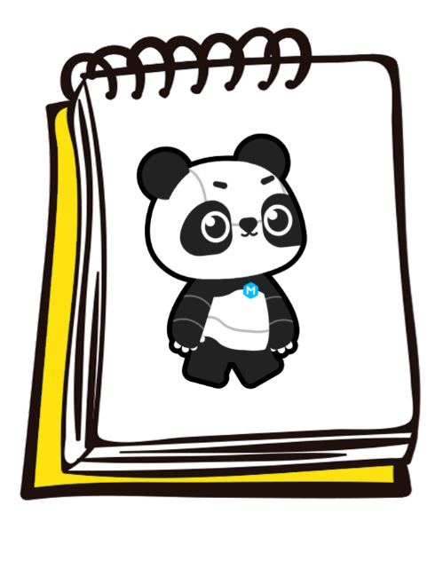
Flipbook animation

Slide 6
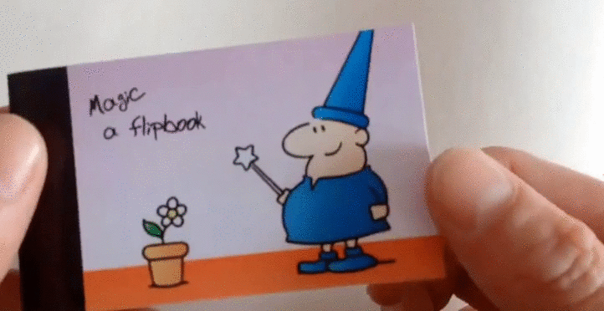

Slide 7
2D Animation

Slide 8


Slide 9
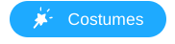
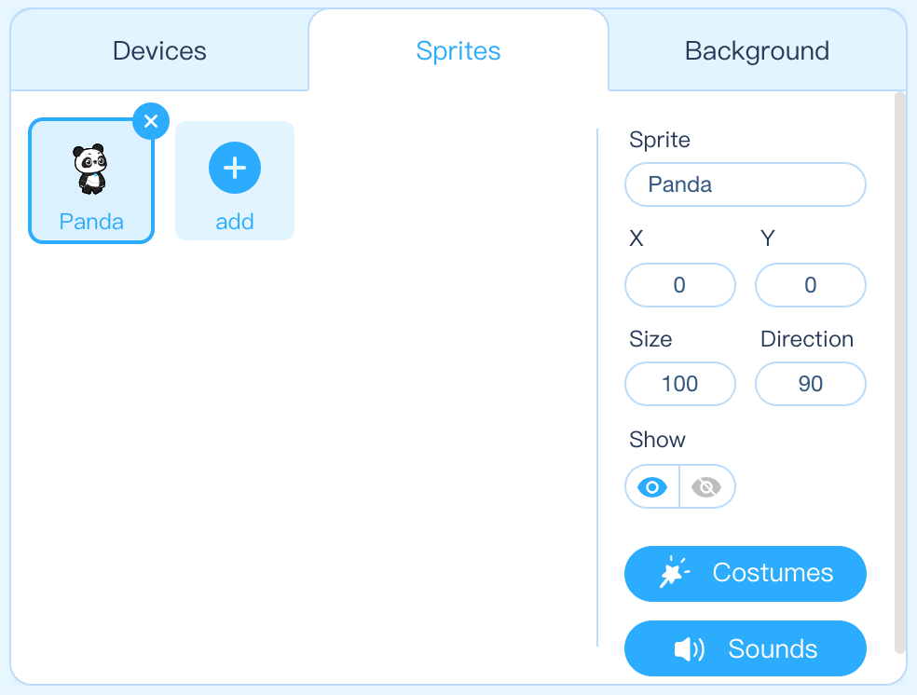
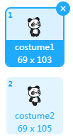
Step 1: Open the mBlock software. Create a new file and click the Sprites tab in the Stage Area to ensure that the Panda sprite is selected. Click the button in the Stage Area to enter the Costumes interface.

Slide 10

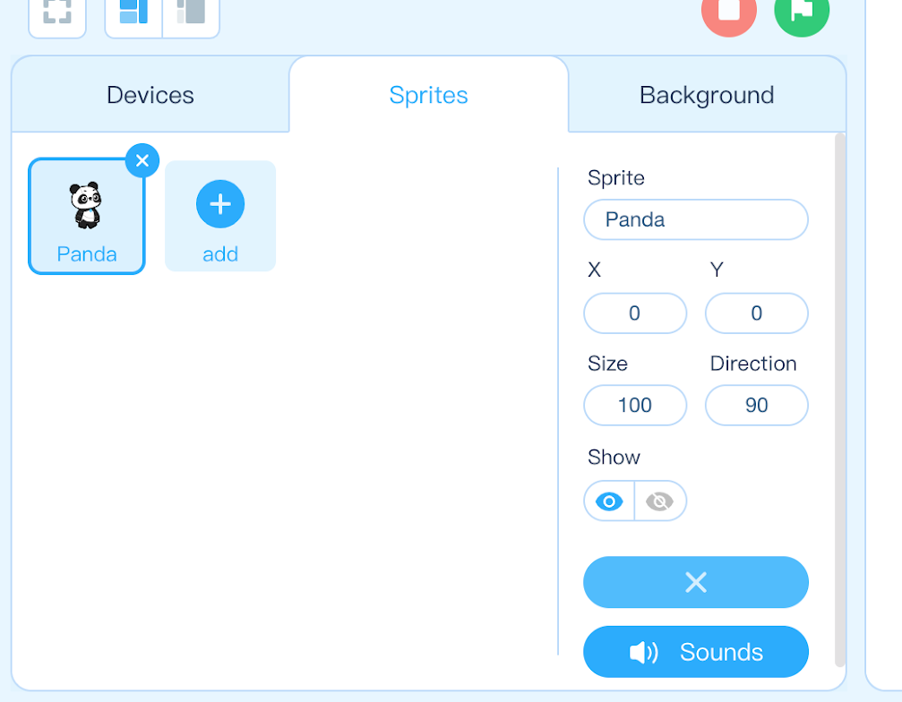
Step 2: Notice, when in the Costumes interface, the button will become an button. You can exit the Costume interface and return to the Programming interface by clicking the
button.

Slide 11
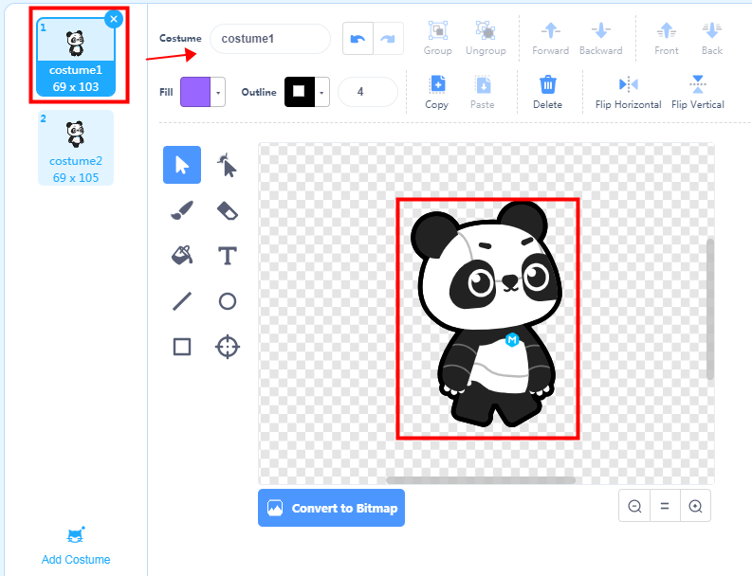
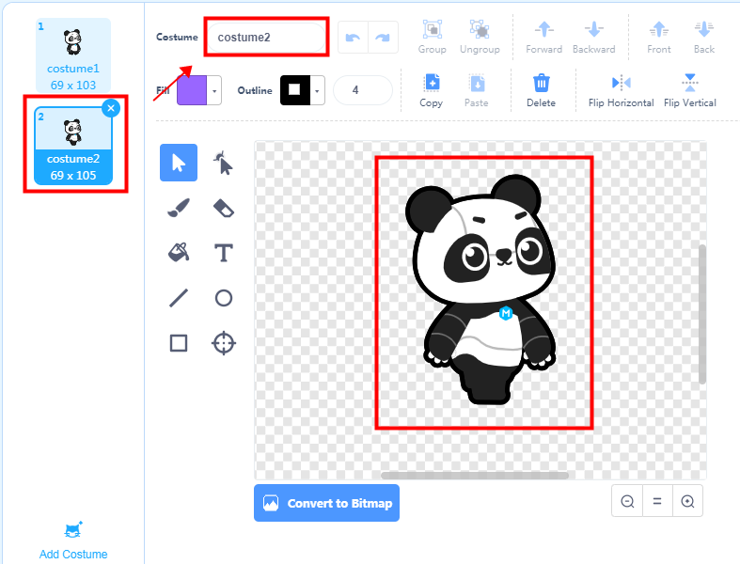
Step 3: The costumes appear on the left column of the costume editing area. Each costume has a unique name. Click on each costume to see the sprite change in the Stage Area.
costume1
costume2

Slide 12
Hands-On

Slide 13
Switch Costumes

Slide 14

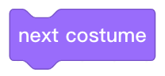
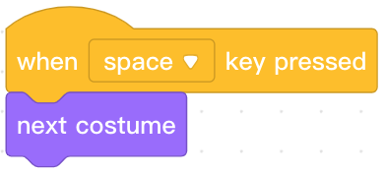
Programming knowledge
Block area | Block | Function | Example
When a sprite has multiple costumes, switch the sprite costume to the next costume

Slide 15
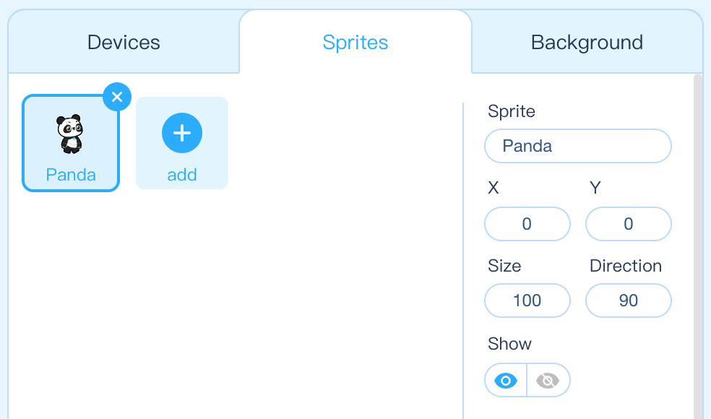

Step 1: Open the mBlock software. Create a new file and click the Sprites tab in the Stage Area to ensure that we are programming the Panda sprite.

Slide 16

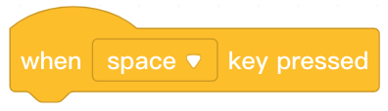

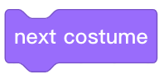
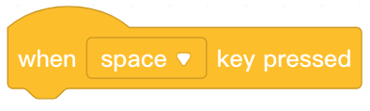
Step 2: Find and select from the Block Area. Click and drag the block to the Script Area and then release it.
Step 3: Find and select from the Block Area. Click and drag the
block to the Script Area and attach it beneath the block.
Step 4: Press the space key several times to run the program and observe Panda switching costumes.

Slide 17
Loop

Slide 18
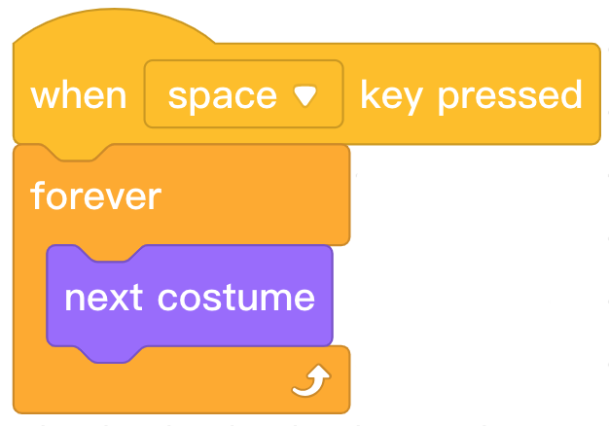
"Loop"
In the computer, a repeated execution is called a loop.

Slide 19
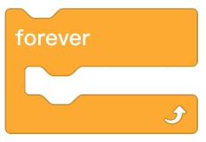

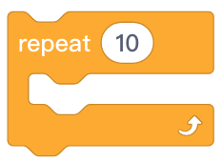
Programming Knowledge
Block area | Block | Function | Example
Continuously repeat the blocks nested inside.
Repeat the nested blocks 10 times and then stop.

Slide 20
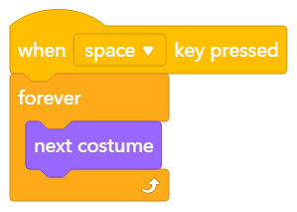
Step 1: Open the mBlock software. Create a new file and click the Sprites tab in the Stage Area to ensure that we are programming the Panda sprite.
Step 2: Find and select the appropriate blocks from the Block Area to create the following program.
Step 3: Press the space key to run the program and observe Panda switching costumes.

Slide 21
Step 4: Repeat steps 2 and 3 using the block instead of the block.
Step 5: Press the space key to run the program and observe Panda switching costumes.
Step 6: Describe the difference between the two programs.

Slide 22
Wait

Slide 23
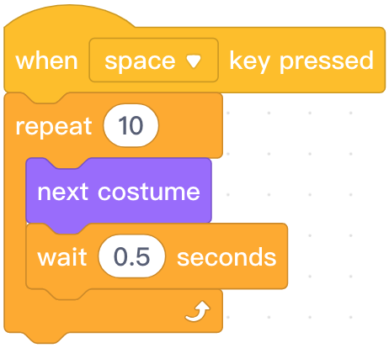

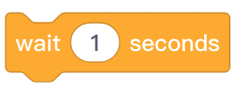
Programming knowledge
Block area | Block | Function | Example
Pause the program and wait the specified amount of time.

Slide 24
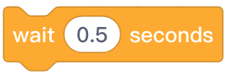
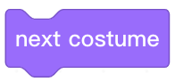
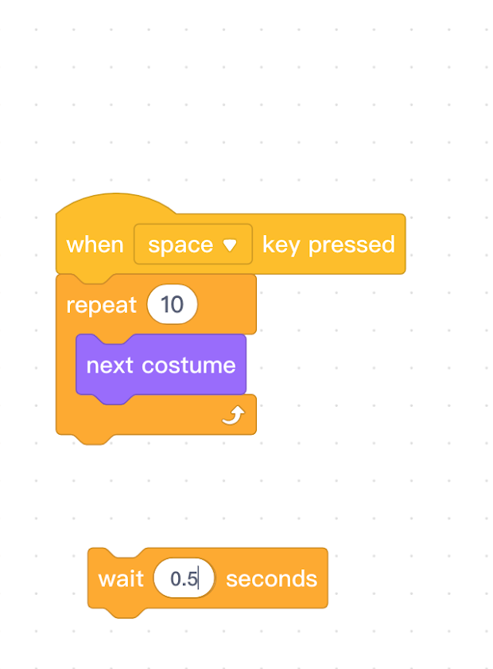
Step 1: Add the block beneath the block nested inside the loop.
Step 2: Press the space key to run the program and observe Panda switching costumes slowly.

Slide 25
Try It

Slide 26
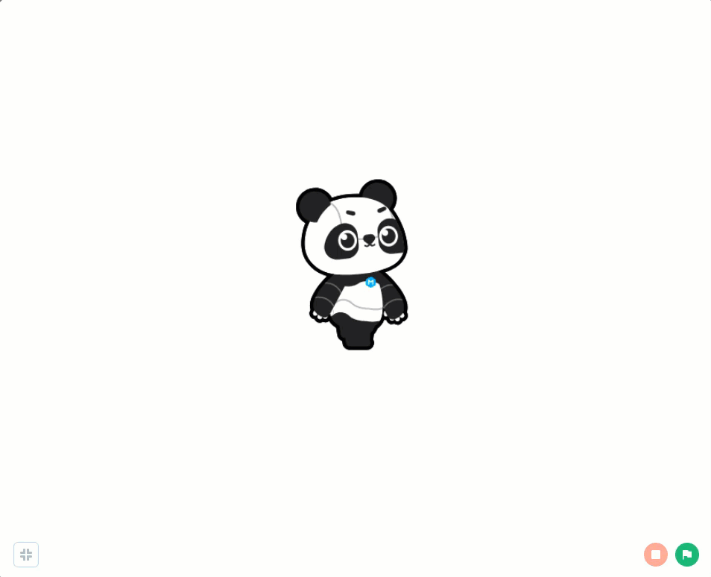

Slide 27
Independent Practice
Walk in Place
Panda says, “I can walk in place!” and then starts moving.
While moving, Panda shouts the costume number of “1” or “2”.
Add an appropriate background.

Slide 28
Extension Activity
Walk in Place
After the Panda walks in place a number of times, say “I can stand still.”, and then take two steps before stopping completely.
Add transformation effects while Panda is walking.
Change the event that triggers Panda to walk.

Slide 29
Review

Slide 30
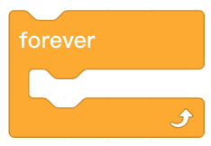
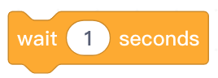
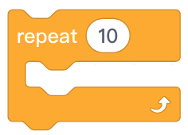
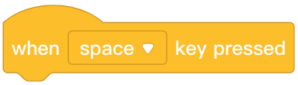
1. Which of the following blocks is not in the control block area?
A.
B.
C.
D.
Notes:
Answer: D

Slide 31
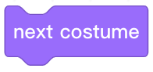


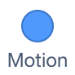

2. Which block area does belong to?
A.
B.
C.
D.
Notes:
Answer: D

Slide 32
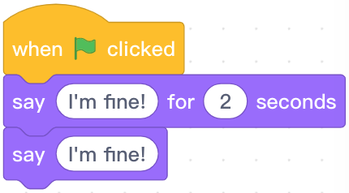
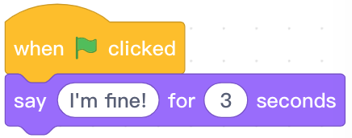
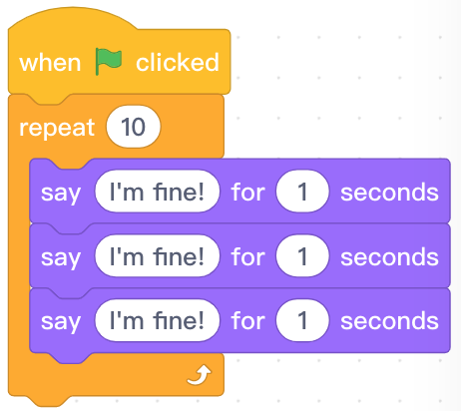
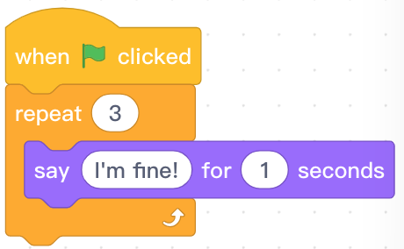
3. Which of the following codes can make the sprite say “I’m fine!” for 3 times?
A.
B.
C.
D.
Notes:
Answer: D

Slide 33
Thank you!

